Slide 1
Chapter 9

Slide 2
Objectives

Slide 3
Objectives (continued)

Slide 4
The syntax for creating an array

Slide 5
The syntax for creating an array and assigning values in one statement

Slide 6
How to create an array and assign values in one statement

Slide 7
The syntax for referring to an element of an array

Slide 8
How to assign values to an array by accessing each element

Slide 9
A property for an array

Slide 10
How to add an element to the end of an array

Slide 11
How to add an element at a specific index

Slide 12
How to remove all elements

Slide 13
A sparse array that contains 999 undefined elements

Slide 14
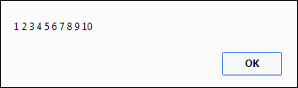
Code that puts the numbers 1 through 10 into an array

Slide 15
Code that computes the sum and average of an array of totals

Slide 16
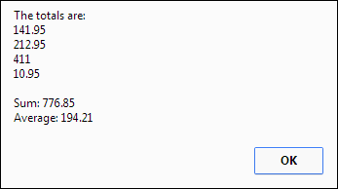
Code that computes the sum and average of an array of totals (continued)

Slide 17
The syntax of a for-in loop

Slide 18
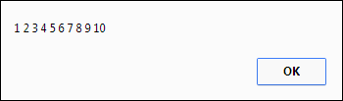
A for-in loop that displays the numbers array in a message box

Slide 19
Code that shows the difference between for and for-in loops

Slide 20
The difference between for and for-in loops (continued)

Slide 21
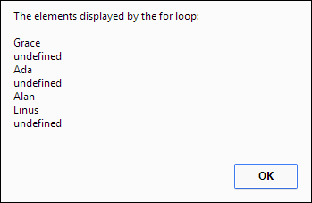
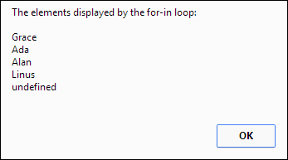
The messages that are created by the loops

Slide 22
The methods of an Array object

Slide 23
How to use the push and pop methods to add and remove elements

Slide 24
How to use the unshift and shift methods to add and remove elements

Slide 25
How to use the splice method

Slide 26
How to use the slice and concat methods

Slide 27
How to use the sort method

Slide 28
How to use the reverse method

Slide 29
ECMAScript 5 methods with simple parameters

Slide 30
ECMAScript 5 methods with functions as parameters

Slide 31
The syntax of the function for most of the methods

Slide 32
How to use the every and some methods

Slide 33
How to use the forEach method

Slide 34
How to use the reduce method

Slide 35
How to use the map method

Slide 36
How to use the filter method

Slide 37
A String method that creates an array

Slide 38
How to split a string that’s separated by hyphens into an array

Slide 39
How to split a string into an array of characters

Slide 40
What happens if the string doesn’t contain the separator

Slide 41
How to get just one element from a string

Slide 42
How to create an associative array with four elements

Slide 43
How to add an element to the associative array

Slide 44
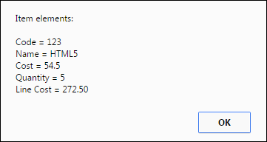
How to retrieve and display the elements in the associative array

Slide 45
How to use a for-in loop with the associative array

Slide 46
How to create and use an array of arrays

Slide 47
How to create and use an array of associative arrays

Slide 48
How to create and use an array of associative arrays (continued)

Slide 49
The syntax for working with local or session storage

Slide 50
JavaScript that uses local and session storage for hit counters

Slide 51
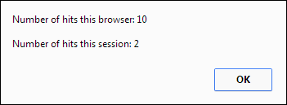
A message box that shows the current value of both hits fields

Slide 52
Terms

Slide 53
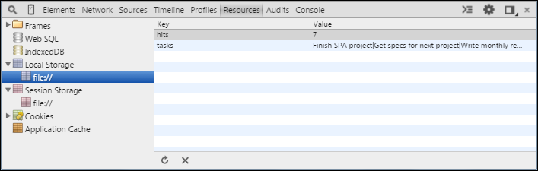
The Resources panel of Chrome’s developer tools

Slide 54
How to use the Resources panel to view local and session storage

Slide 55
How to use the Resources panel to delete a storage item

Slide 56
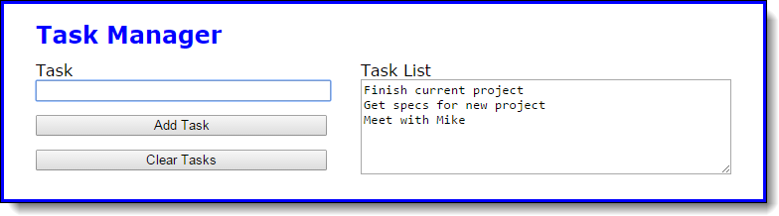
The Task Manager application

Slide 57
The HTML for the application

Slide 58
The CSS for the “tasks” id

Slide 59
The string that’s stored in local storage

Slide 60
The JavaScript for the Task Manager application

Slide 61
The JavaScript (continued)

Slide 62
The JavaScript for the enhanced application

Slide 63
The JavaScript (continued)

Slide 64
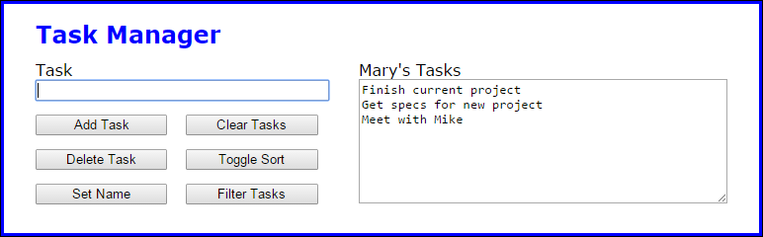
Exercise 9-1 Enhance the Task Manager app

Slide 65
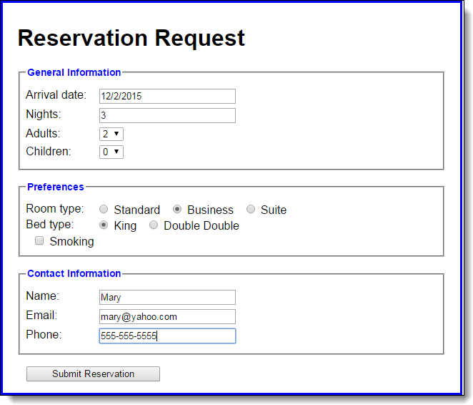
Extra 9-1 Save a reservation in session storage

Slide 66
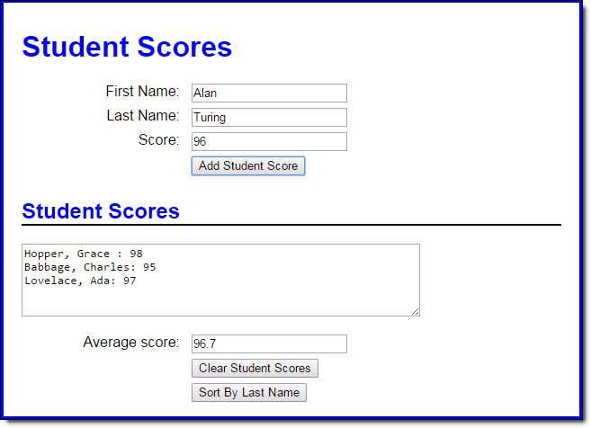
Extra 9-2 Develop the Student Scores app

Slide 67
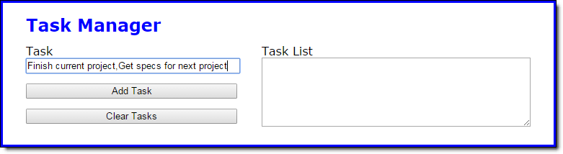
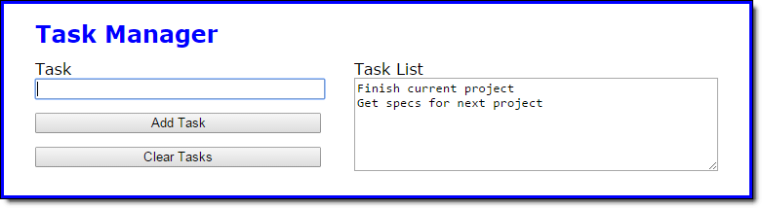
Short 9-1 Allow multiple tasks in a single entry

